Slide 1
Bilder PASS Ontologie

Slide 2
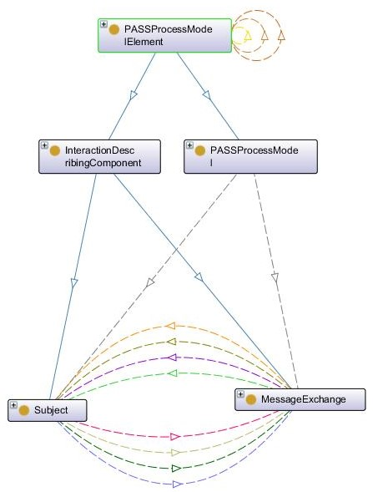
Subject Interaction
1
2
3
4
5
6
7
8
9
10
11
12
13
14

Slide 3
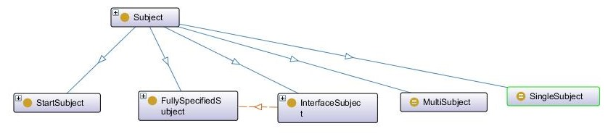
Types of subjects
30
31
32
331
34

Slide 4
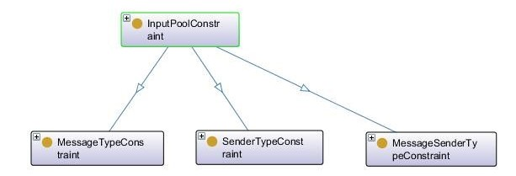
Input Pool
35
36
37

Slide 5
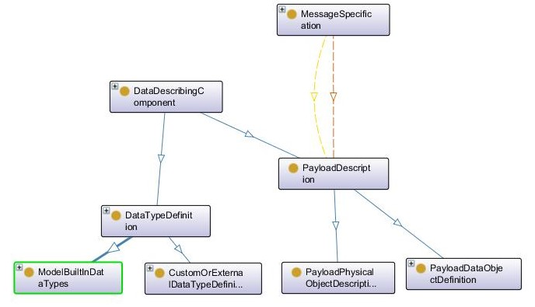
Message Specification Payload
42
41
44
431
46
45
47
48

Slide 6
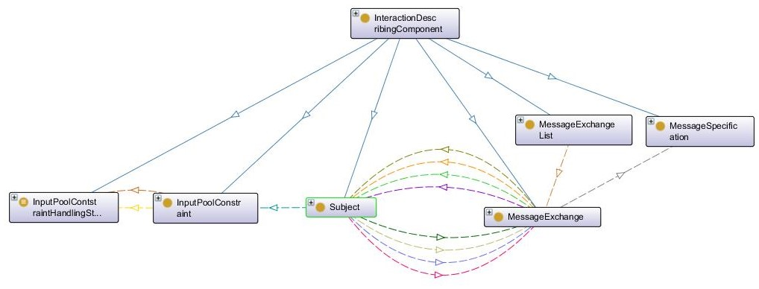
Interaction describing component
3
4
531
54
51
52
12
13
56
57
58
14
15
59
50
16
17
18
19

Slide 7
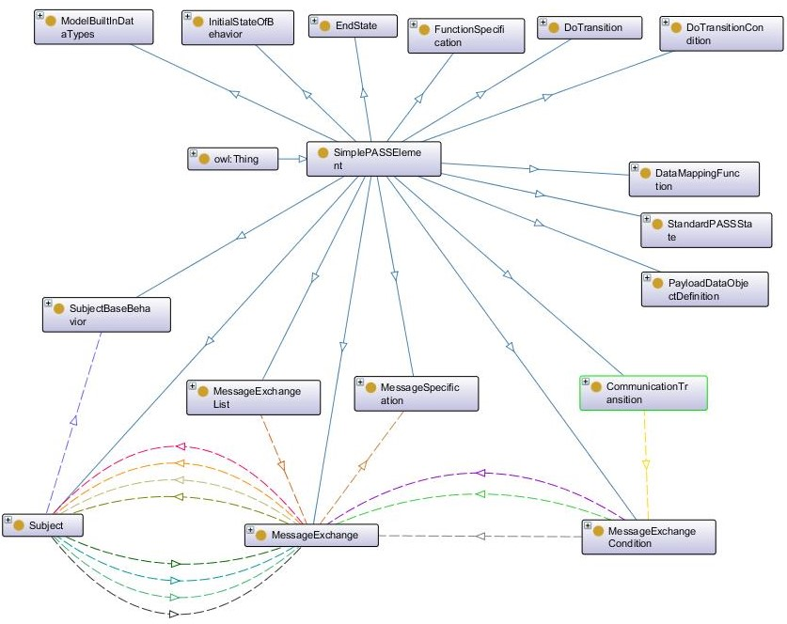
81
82
831
84
85
86
7
87
8
9
88
1
96
89
2
95
94
93
92
91
90
97
12
10
11
98
14
13
99
15
100
101
16
17
18
19

Slide 8
1
2
7
21
231
8
9
20
10
22
24
17
11
19
12
16
3
4
5
6
13
15
18
14

